Slide 1



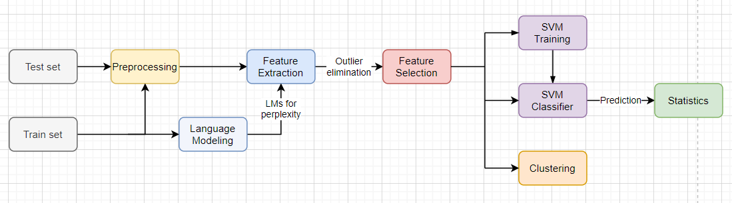
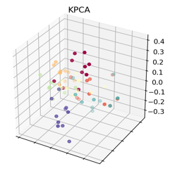
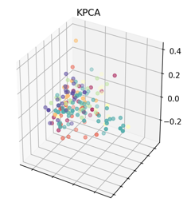
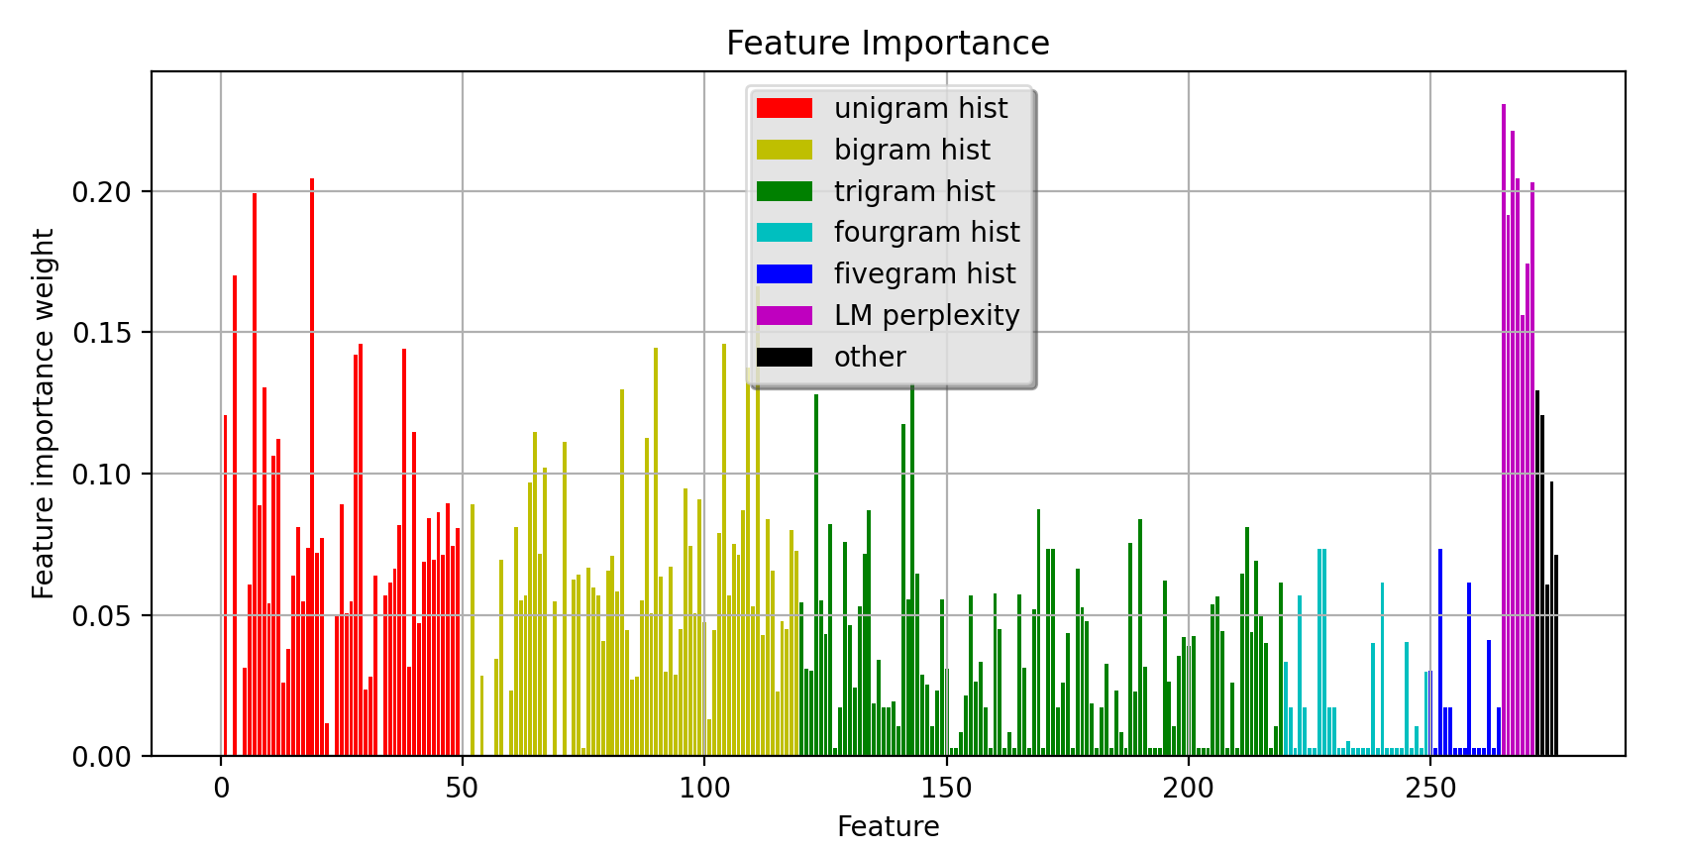
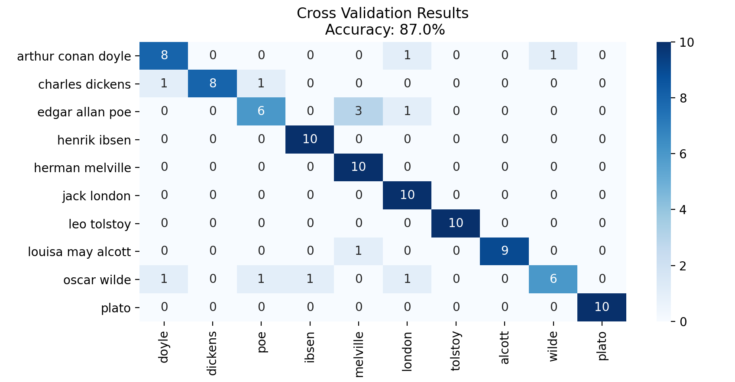
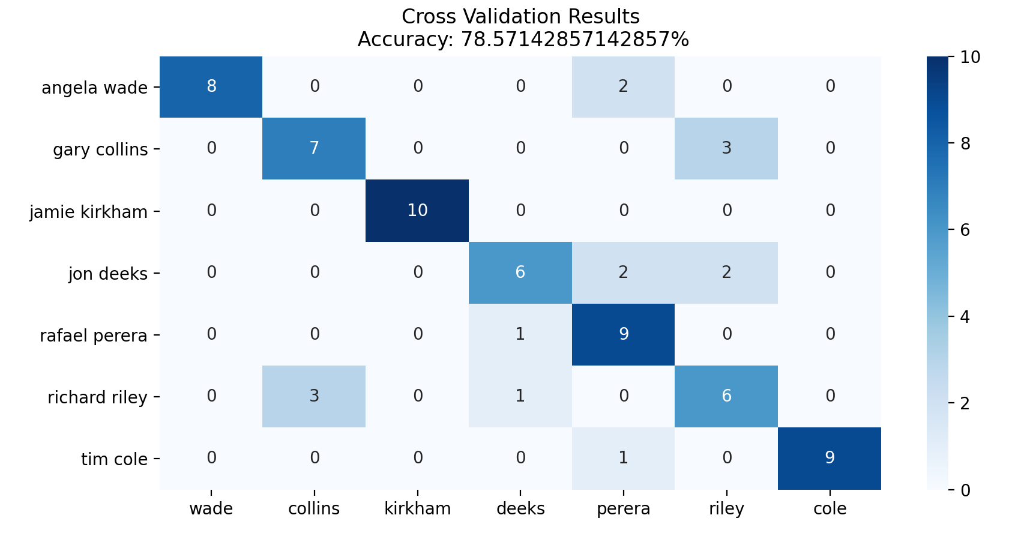
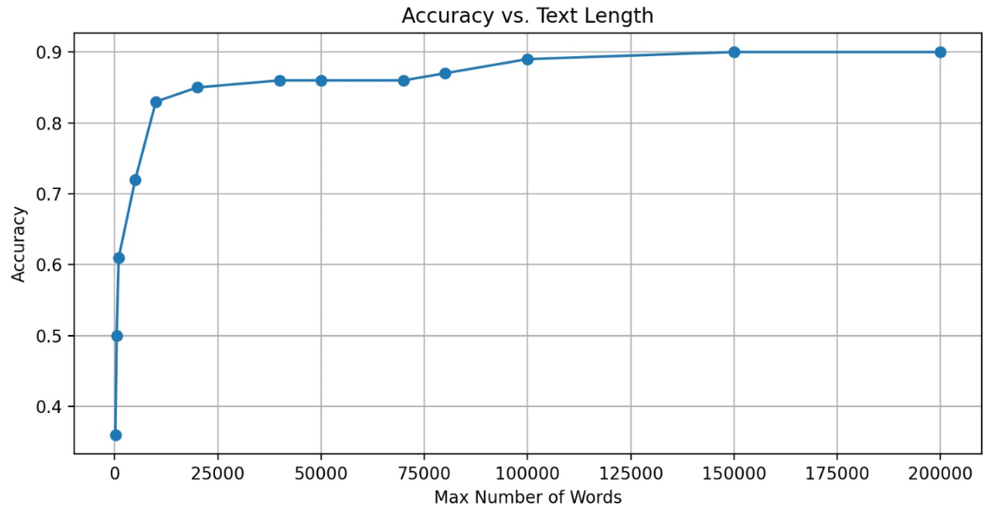
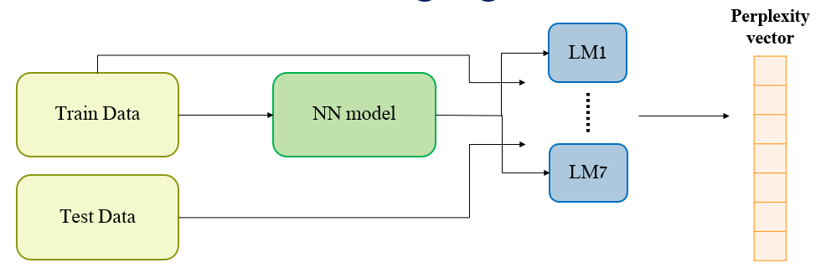
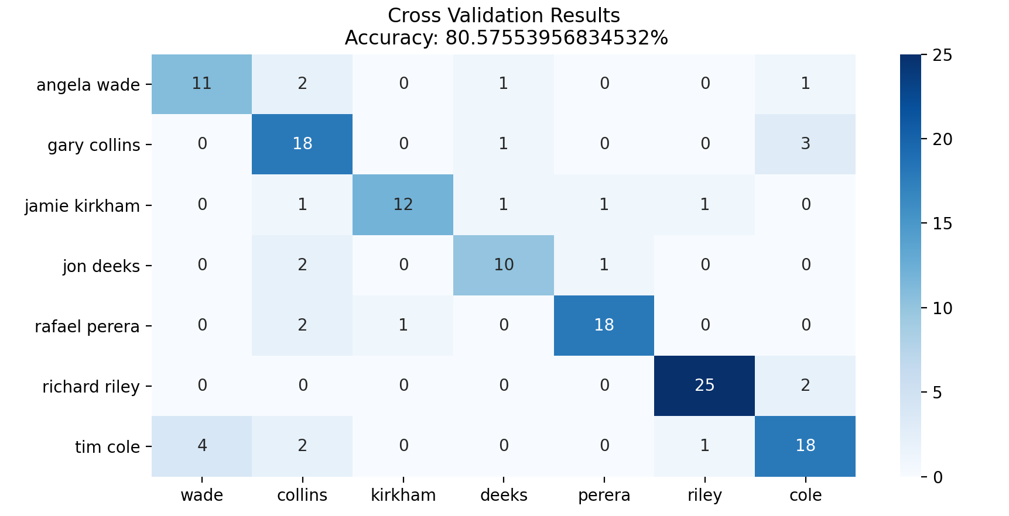
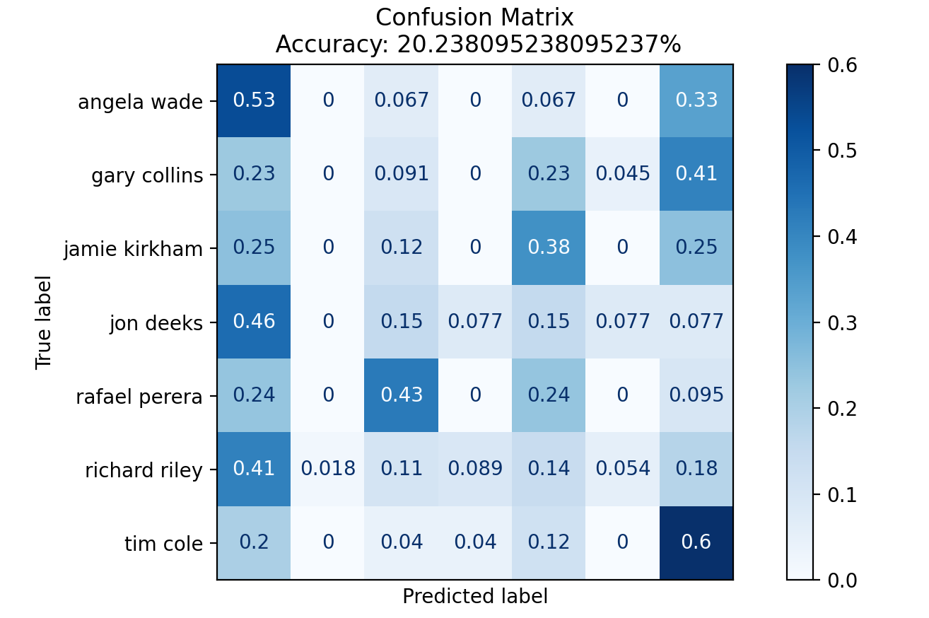
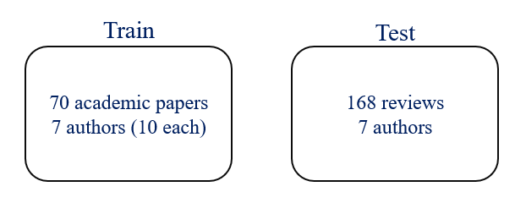
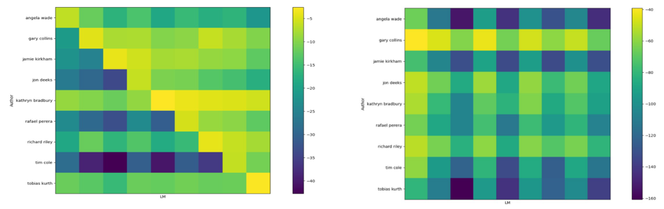


Signal and Image Processing Lab
Identification of an Anonymous Reviewer of an Academic Paper
Lior Kiassi, Roy Hachnochi, Supervised by Pavel Lifshits
Introduction
Project Diagram
Clustering
Commonly, as part of the process of publishing a scientific paper, the work undergoes peer review.
“Double Blind” – the author and the reviewer are anonymous to each other.
Today, due to transparency reasons, several well-known journals publish their reviews.
Finding outliers in dataset – OPTICS algorithm.
Samples visualization.
Manifold learning – learning the feature space of the train set and the test set.
Goals
Study the domain of a new problem – reviews on academic articles.
Research how to perform authorship attribution on this domain by learning a different domain.
Stepping-stone towards the following:
Obfuscation of reviews’ authors.
Dealing with the cross-domain problem – learning on articles and inferring on reviews.
Preprocessing
Tokenizing.
Ignoring stop words.
Lemmatization.
Replacing numbers and signs with ‘<UNK>’.
Articles
Reviews
Feature Selection
Eliminate bad features (for both domains) with reliefF algorithm.
For example – articles:
Challenges
Features
No existing labeled ground truth.
Reviews are short texts.
Reviews and academic papers are topic related.
Cross domain work.
Most articles are written by multiple authors.
n-gram histograms:
$n∈\{1,2,3,45\}$
TF-IDF normalization: $h\left[i\right]=\frac{n_{i}}{N}⋅\log\left(\frac{D}{N_{i}}\right)$
Average word length.
Number of words.
Average number of words in a sentence.
Histogram of the following punctuation signs: , : -
Toy Problem
Results
Small dataset: 100 texts – 10 Authors x 10 books (Guttenberg project).
Goal: create an author classifier (90% Acc.).
Accuracy vs. text length:
Features – Language Models
Toy problem
Articles - Articles
Articles - Reviews
Reviews - Reviews
Dataset
Language model for each author.
Calculates the probability for the next word.
LSTM – Huggingfaces’ Transformers with GPT2.
Perplexity as feature: $perp\left(x\right)=e^{−\frac{1}{N}\sum_{i=1}^{N}{\log\left(P_{θ}\left(x_{i}\right)\right)}}$
Perplxity indicates the likelihood of a text to be associated with a language model.
Gives understanding of vocabulary, writing style and more.
Indicates on the stability of our model for various problems.
Stepping-stone for possible future work.
Cross-domain problem hasn’t been dealt with – for future work.
Challenges:
Hard to find (especially labeled ones).
Review’s authors write only few reviews in total.
Short texts without meaningful context.
Different text structures – hard for automation.
Difficulty to obtain papers of a specific person.
Structure:
Conclusions
Good results on a naturally challenging domain.
Future work – domain adaptation.
The quality and size of the dataset have impact on the results.
Text length may have a great impact on results.
Using language models and perplexity is a highly valuable feature for this task.
Feature selection is important when dealing with high feature dimension.
Reviews - BMJ (British Medical Journal).
Articles - various sources.
Articles - Articles
Articles - Reviews
November 2020

